Slide 1
The circular strategy game
June 2018

Slide 2
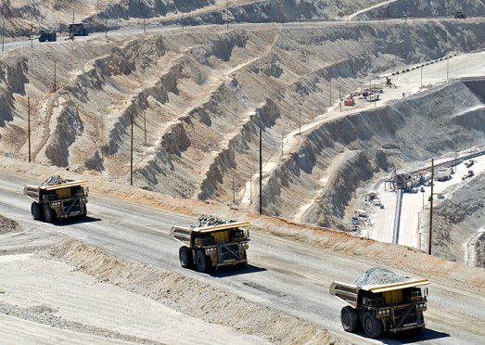
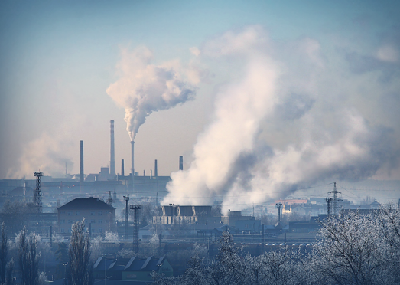
Chapter 1
WHY CIRCULAR ECONOMY?
The world is inhabited by a growing number of people. An ever larger share of them is living in cities and is ageing.
Wealth is increasing globally, creating a larger middle class, for which we extract more and more natural resources
Causing increasing CO₂ footprints and waste production. As a result, global consumption currently goes above and beyond the earth’s regenerative capacity.
The linear “Take – Make – Dispose” system which depletes natural resources and generates waste is deeply flawed and can be productively replaced by a restorative model in which waste does not exist as such but is only food for the next cycle.
- Ellen MacArthur Foundation -

Slide 3
Chapter 2
THE CIRCULAR ECONOMY PROVIDES
NEW BUSINESS OPPORTUNITIES
The upside is clear to many …
… but what does this mean in practice
and which challenges will you encounter?
Increase in economic growth* with 1% to 4% through circular strategies which entail maintenance & repair, reuse, remanufacturing, refurbishment and recycling.
Valuation of materials and components
Laws and regulation
These strategies enable companies to:
Enter new markets (C2C and C2B)
Gain market share
Offer new / differentiating (service) propositions
Create competitive advantage
Utilize latest technology
Apply solutions to sustain our planet & their business
Counterparty risk
Value chain collaboration
Control mechanisms
Reverse logistics
Ownership of goods
Product quality
* Ellen MacArthur Foundation

Slide 4
“Tell me and I forget,
teach me and I remember,
involve me and I learn.”
- Benjamin Franklin

Slide 5
Chapter 3
INCHAINGE, ING AND WINDESHEIM ARE DEVELOPING AN ONLINE BUSINESS SIMULATION…
Enhance knowledge
Networking
Align roles / stakeholders
Have fun
Building profile
Create leads
…to help companies and individuals understand and experience the opportunities and challenges of adopting circular strategies.
Simulation gaming is a powerful way to facilitate learning, engage with clients and to profile your expertise.
Game setup in a nutshell
Participants play the online simulation in teams of 4 people; either virtually or in class room setting.
Minimum playing time is 4 hours, but it can be stretched over a longer period as well

Slide 6
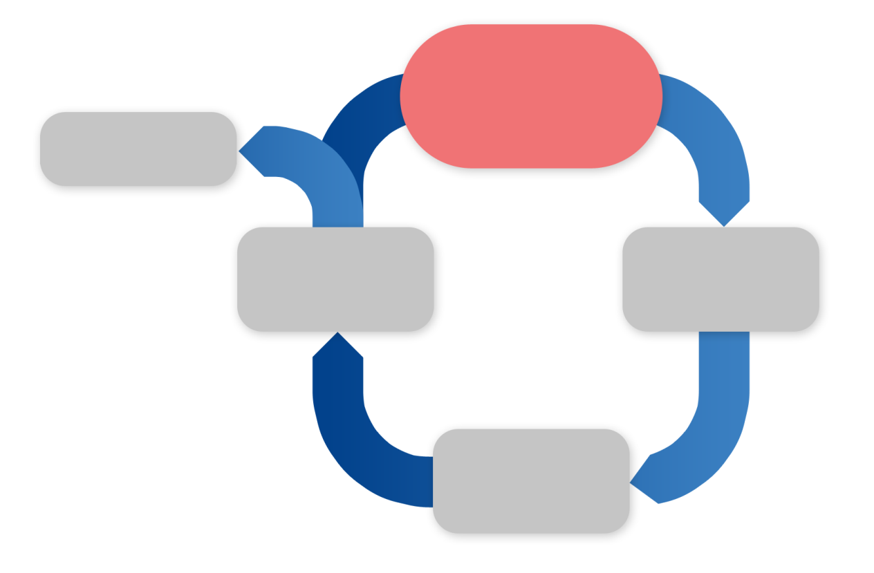
Chapter 4
EXPERIENTIAL LEARNING IS A POWERFUL AND PROVEN APPROACH WHICH IS AN INTEGRAL PART OF THE SIMULATION AND THE TRAINING SESSION.
Real Life
Business Simulations (micro cycle)
EXPERIENCE
ELSEWHERE
Exercise
Workshops
Break-outs
Coaching
Feedback
Evaluations
Discussions
Presentations
APPLY
MACRO CYCLE
REFLECT
CONCEPTUALIZE
Models & Tools
Presentations
Case studies

Slide 7
Game design

Slide 8
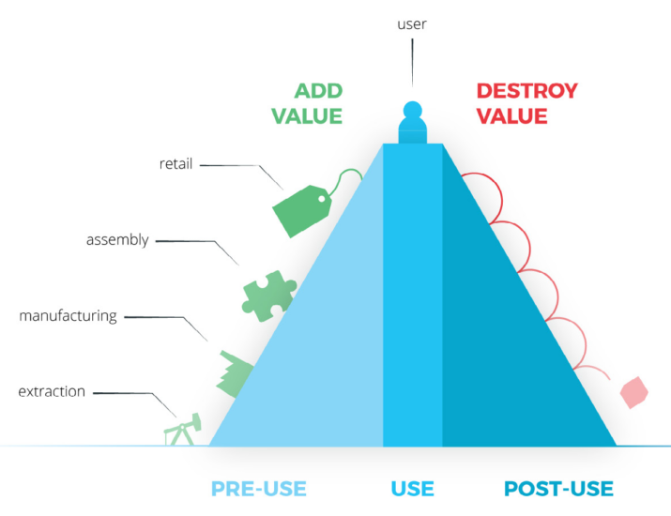
Achterberg, E., Hinfelaar, J., & Bocken, N. (2016). Master Circular Business with the Value Hill
Notes:
Achterberg, E., Hinfelaar, J., & Bocken, N. (2016). Master Circular Business with the Value Hill. Amsterdam. Retrieved from http://www.circle-economy.com/master-circular-business-with-the-value-hill/

Slide 9
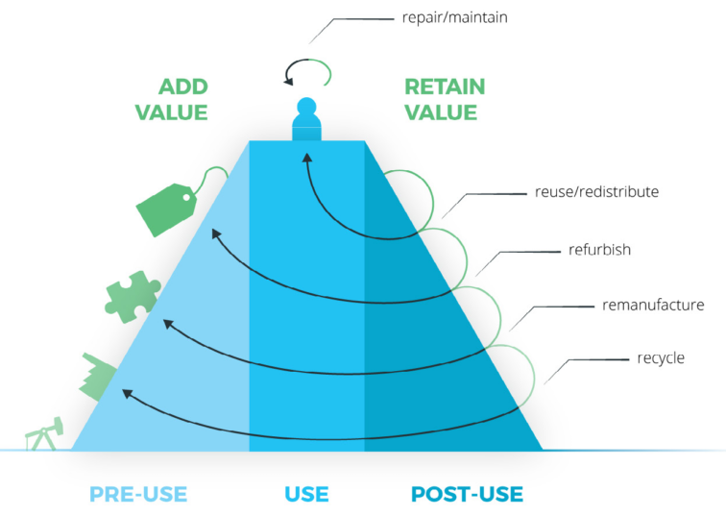
Achterberg, E., Hinfelaar, J., & Bocken, N. (2016). Master Circular Business with the Value Hill

Slide 10
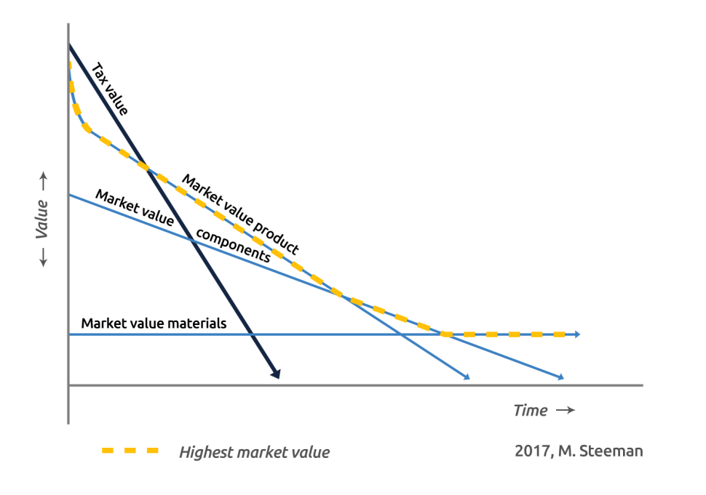
The value profile of products

Slide 11
Three transition challenges
1. Residual value
Waste does not exist.
Value is kept
2. Ownership
Maintenance Balance sheet extension
3. Cash flow
Pay per use models

Slide 12
Cashflow implications

Slide 13
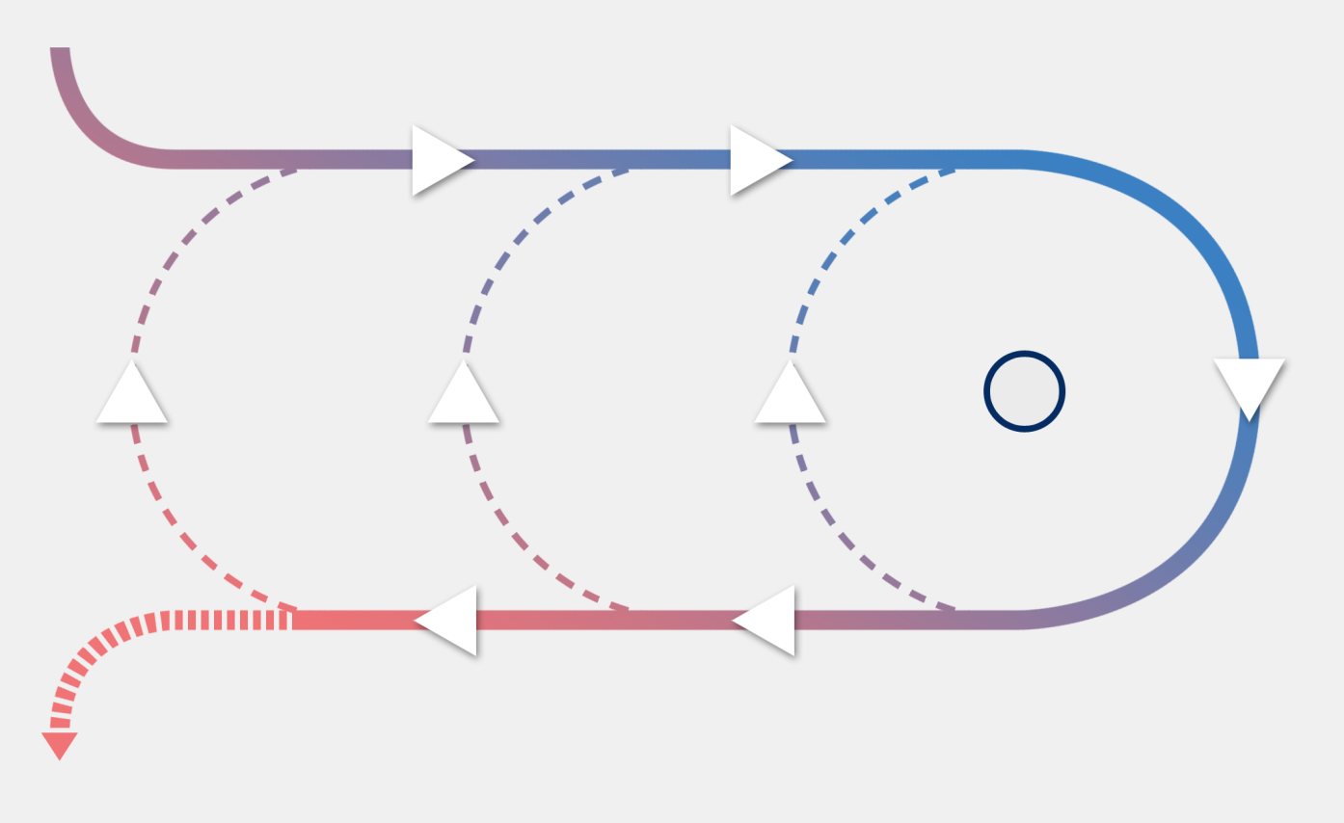
THE TASK OF THE TEAMS IS TO TRANSFORM THE BUSINESS MODEL FROM LINEAR TO CIRCULAR, ENSURING A HEALTHY ROI AND CIRCULARITY INDEX (MCI)
Raw materials
The Circular Economy strives for a closed loop system.
Products and component materials are reused and recycled at their highest value in the cycle, reducing the inflow of virgin materials.
Waste does not exist as such, but is only food for the next cycle.
The participants will explore which circular strategies fit best, and how to implement these given the company’s product categories and stakeholders
Procure
Manufacture
Distribute
Market
Circular supplies
Product-as-a-service
CUSTOMERS
Resource recovery
Product life extension
Sharing platform
Gather
remaining elements
Collect
parts/materials
Pick up products
from users
Waste

Slide 14
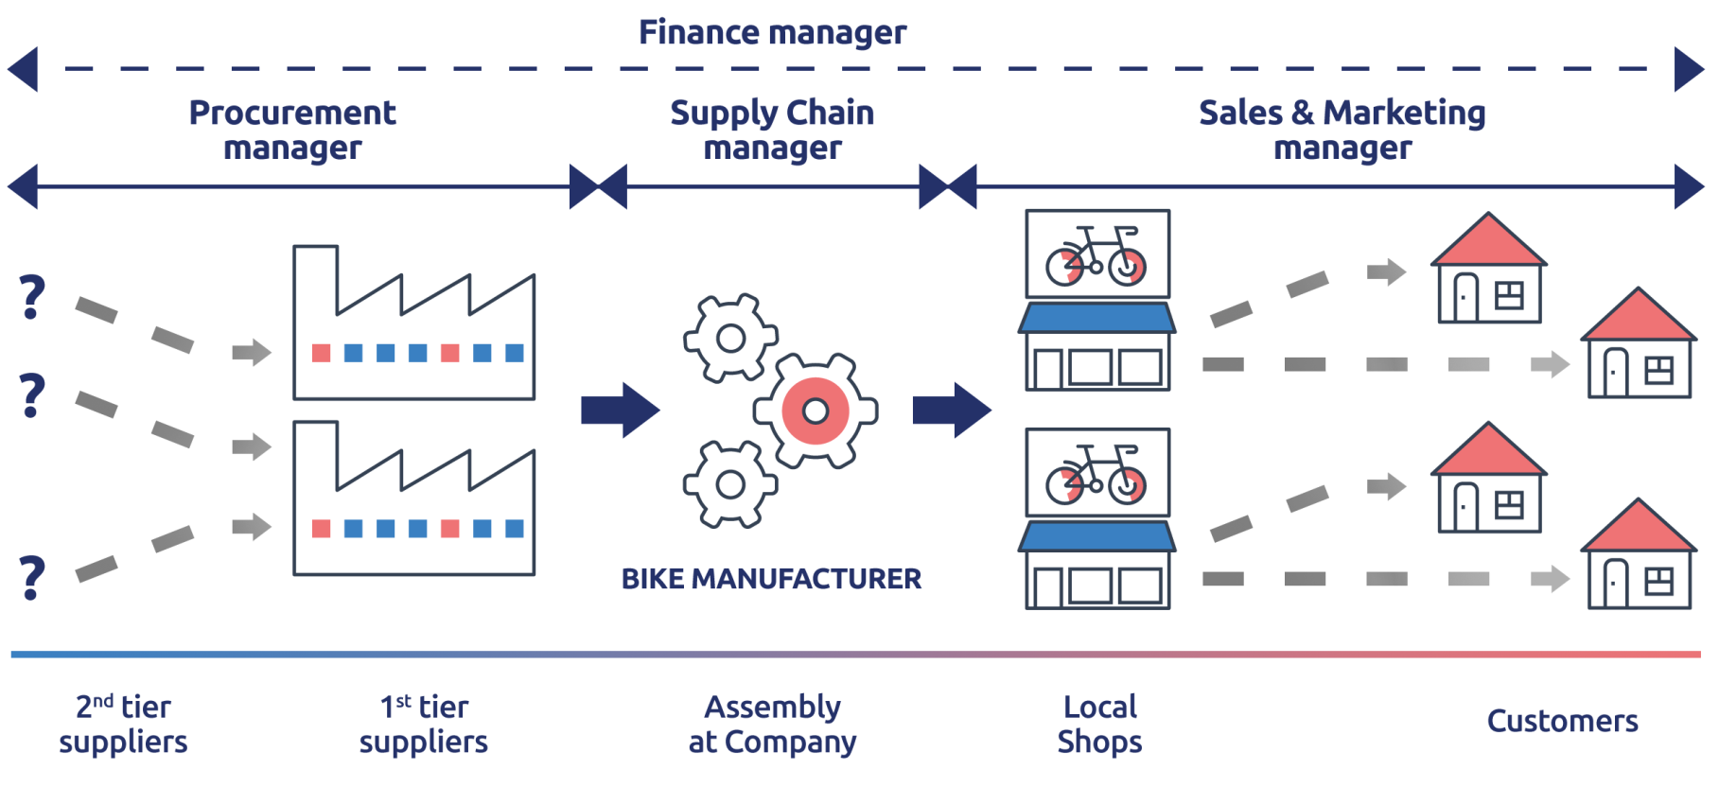
CHALLENGES YOU NEED TO ADDRESS AS A MANAGEMENT TEAM TOGETHER WITH BUYERS AND SUPPLIERS
4 roles
1 team
1 mission
Sustain your company

Slide 15
EACH ROLE HAS ITS OWN CHALLENGES TO MANAGE
Purchasing
Supply chain
Negotiate conditions with different types of suppliers regarding:
purchasing contracts (e.g. quality, reliability, sustainability)
material sales contract (e.g. volume, reliability)
service contract (e.g. ownership, warranties)
Negotiating with the Recycling and Logistics Service Providers on quality and volumes
Decisions regarding safety stocks and lot sizes in light of reverse products flow
Decisions regarding maintenance programs and warehousing
Negotiate conditions with different types of buyers regarding:
sales contracts (e.g. MCI, INCOterm)
repurchase contract (e.g. quality, volume)
service contract (e.g. ownership, lease, maintenance, warranties)
Negotiating with the Financial Service Providers (e.g. Vendor lease, Loans, Insurance)
Decide on Buyback value of the repurchased products
MCI ambition level for the whole company
BIKE
MANUFACTURER
Sales
Finance

Slide 16
LAUNCH PLAN

Slide 17
TIMELINE AND PLANNED ACTIVITIES FOR TESTING, TUNING AND LAUNCH CHALLENGE FOR PROFESSIONALS AND STUDENTS
May – Sept ‘18
Oct – Dec ‘18
Jan – Dec ‘19
Development,
Testing & Tuning
Onboarding partners
Test & Tune with partners
Test & Tune with partners
Internal simulation sessions for partners
City Tour to >20 cities
Invite local companies, universities, NGO, gov’t and consultants
Preparations for 2nd release

Slide 18
APPENDIX

Slide 19
APPENDIX

Slide 20
WHO WE ARE?
About Inchainge
We are a Netherlands-based company specialized in developing and marketing of simulations and learning programs in Supply Chain Management and Supply Chain Finance, with a network of delivery partners on every continent. Our simulations, The Fresh Connection and The Cool Connection, focus on what we truly believe to be vital for every organization: Alignment.
From strategy to action
From theory to practice
From finance to physical supply chain
From sales to procurement to operations and planning
From service providers to corporates
www.inchainge.com
About ING Wholesale Banking
ING Wholesale Banking (WB) meets all banking needs of large corporations, multinationals and financial institutions. With a history that stretches back some 200 years, we have made a name for ourselves by helping clients build successful businesses. We do this by ensuring we understand their unique needs, by being a trusted advisor to them for the long term and by proactively creating innovative solutions and executing them flawlessly.
We finance growth, manage the day-to-day banking needs of our clients and provide them with a full range of banking solutions to help to achieve their business goals.
We are a truly international team of more than 11,000 banking professionals with local knowledge and a presence in more than 40 countries.
www.ingwb.com
About Windesheim
Windesheim is one of the Netherlands' top universities of applied sciences, known for its personal approach and for working closely with the business community and public institutes.
With well over twenty-five thousand full-time and part-time students and more than two thousand staff at sites in Zwolle and Almere, Windesheim is one of the largest universities of applied sciences in The Netherlands. We are a broad-based institute that offers a wide range of accredited Bachelor's degree courses
www.windesheim.nl

Slide 21
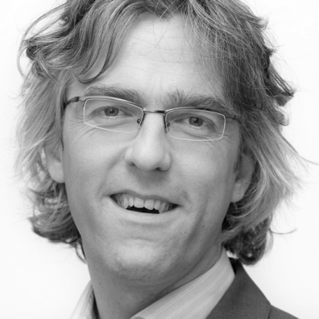
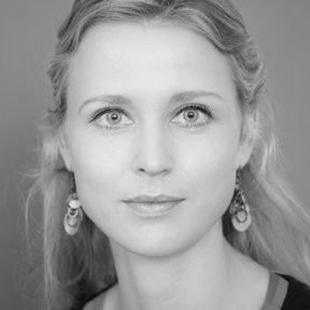
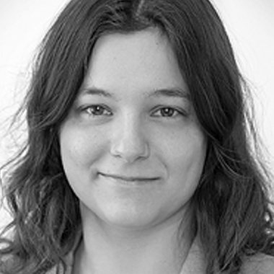
CURIOUS TO HEAR MORE?
Michiel Steeman
Tel: +31 6 31960781
Email: m.steeman@inchainge.com
Marloes van Elsen
Tel: +31 6 30491160
Email: marloes.van.elsen-bergevoet@ing.nl
Lisa Zom
Email: lm.zom@windesheim.nl

Slide 22
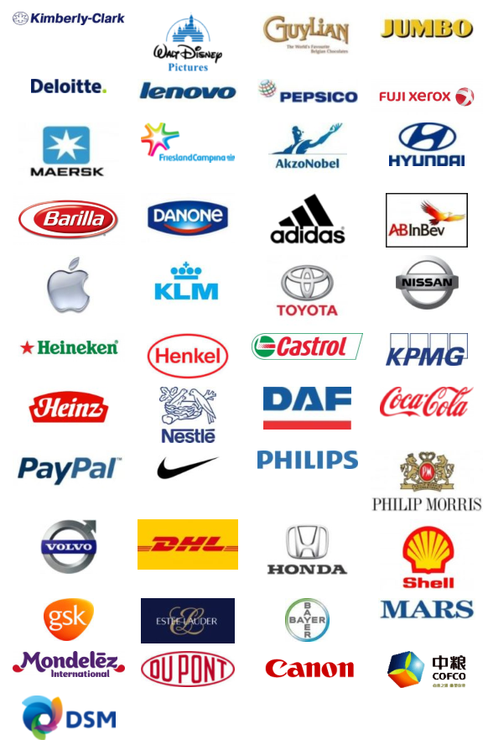
The Fresh Connection: Track Record
The Fresh Connection (TFC) delivers the ultimate value chain learning experience. Developed by Inchainge in 2008, it has been experienced by more than 25,000 professionals in 600 companies across the world:
Fortune Global 500: 40% of the top 100 manufacturing businesses are using TFC
Gartner Supply Chain Top 25: Over 50% are using TFC
Global top 10 of 3rd Party Logistics Providers: 40% are using TFC
Used by more than 300 universities around the globe
www.thefreshconnection.biz

Slide 23
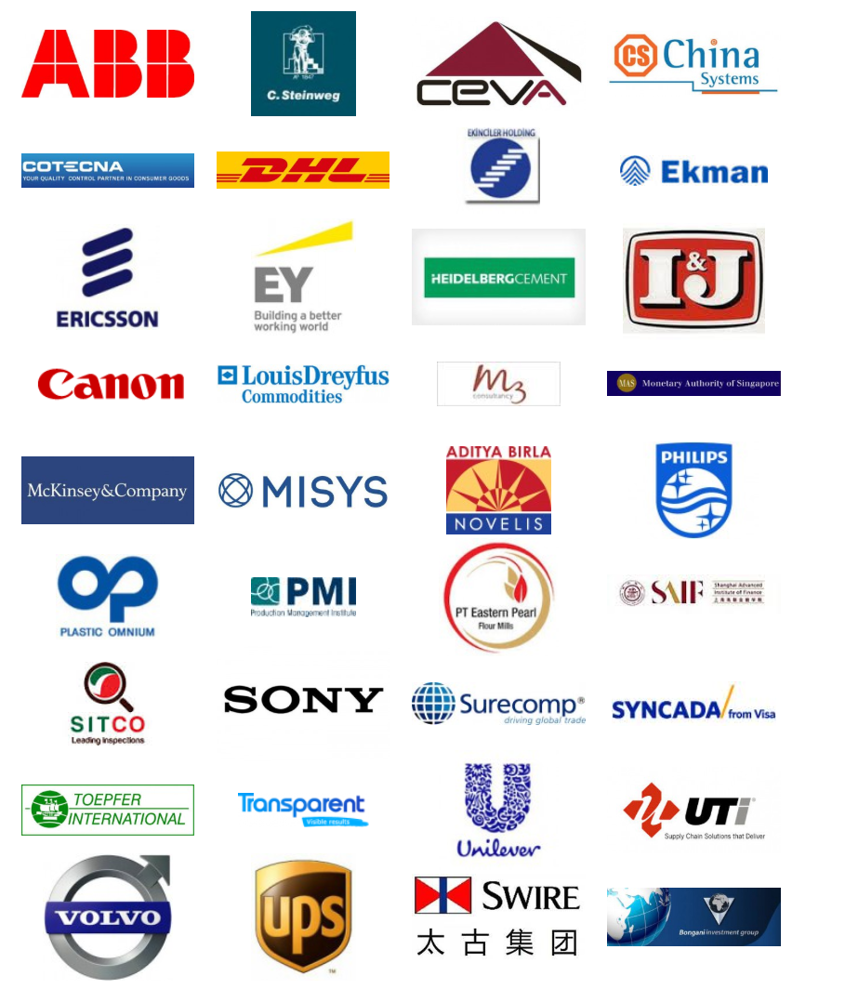
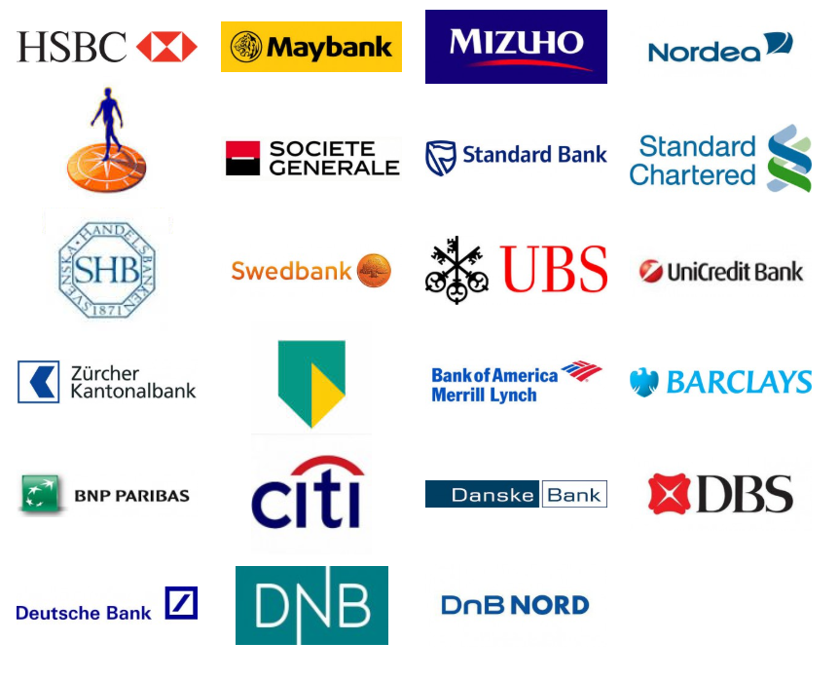
The Cool Connection: Track Record
The Cool Connection delivers the ultimate (financial) supply chain learning experience bridging physical and financial supply chains.
Developed by Inchainge in 2012, The Cool Connection has already been experienced by many professionals in a wide variety of companies and banks across the world.
Experienced by more than 300 universities globally.
www.thecoolconnection.org

